Slide 1
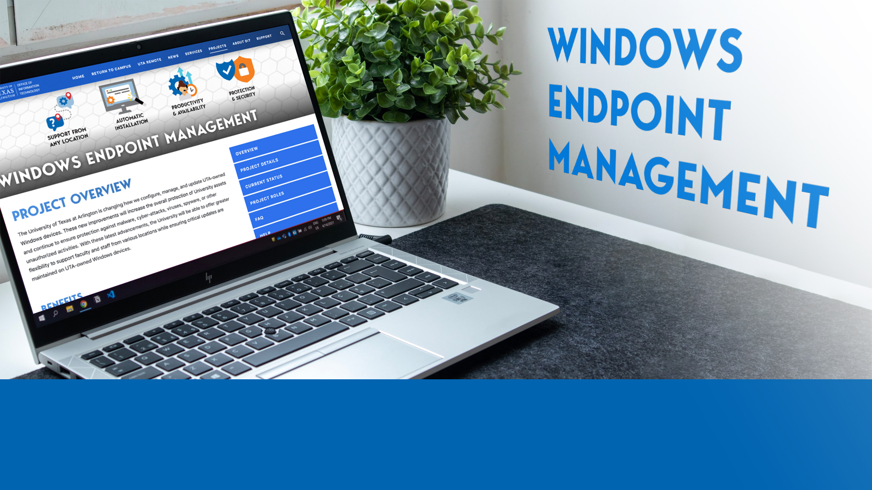

Windows Endpoint Management
Cheryl Nifong, Chief Information Security Officer, ISO
Jeff Neyland, Chief Information Officer, OIT

Slide 2



The Need for Windows Endpoint Management
Management of Endpoint devices has become a critical risk since moving to remote work.
UTA is responsible for managing its computing devices as well as mitigating and reducing cybersecurity risk.
OACS, ISO and OIT are collaborating on the Windows Endpoint Management (WEM) project to help prevent attacks against UTA-owned devices.

Slide 3



Policy, Timeline and Impact
Timeline
DSA and User Management
Information Security and Acceptable Use Policy
There will be a phased rollout by department, but users are encouraged to sign up early if schedules permit. The target completion date is May 2022.
DSAs will be able to manage departmental devices. If you have a DSA, they will complete these steps for you. Users who can install software will be able to do so for the near future.
WEM is required per IT-PO-03: "All UTA owned endpoint computing devices will be managed by a centralized Endpoint Management solution to ensure required security controls are enforced."

Slide 4


Project Scope
In Scope
Out of Scope
All UTA-owned Windows machines assigned to:
Staff and Student Workers
Conference Rooms
Faculty
Instructional Labs
Research Labs
Classrooms
Servers
Desktop phones used with MS Teams
Devices granted formal exception by ISO
Non-UTA owned devices such as student-owned devices and smartphones
MacOS, iOS, and Android devices
Anti-virus or anti-malware management on MacOS and iOS devices

Slide 5

WEM Preparedness Toolkit
Windows Endpoint Management
Preparedness Toolkit
Office of Audit and Consulting Services | Information Security Office | Office of Information Technology

Slide 6




Understand the Benefits of the Endpoint Management
Support from
Any Location
Automatic Installation
Productivity
and Availability
Protection
and Security
Allows users to access support
from various locations by troubleshooting issues through a secure online console
Increases access
to applications by automatically installing software on any UTA-owned Windows device from any location
Increases productivity by automating routine tasks and providing access to software and security policies through an online console
Ensures devices are running properly and securely with the latest security updates, anti-viruses, and security patches

Slide 7




Prepare Your Device (~2 hours)
Back Up Files
and Folders
Document
Software
Identify
License Keys
Sign Out
of Applications
Prepare for the upgrade by using OneDrive to back
up files and folders saved on your device.
Document software that will not be installed after the update (including
purchased and
free applications.)
Identify license keys that are required to reinstall applications. See the software vendor for more information.
Sign out of applications associated with your email account, such as Adobe Creative Cloud.

Slide 8




Know What Happens During the Update
OIT - Reimage and Update
OIT - Erase Device for Reset
OIT - Reset to Factory Settings
You - Download Files from Backup
OIT will reimage your device(s). Files, folders, applications, and settings will
be deleted to apply the update.
Files, folders, applications, and settings will be erased and no longer available unless they were backed up.
Your device(s) will be reset to factory settings. Windows and some critical applications will be pre-installed.
You will need to download and sync files and folders from your backup location in OneDrive and reinstall applications.

Slide 9




Schedule an Appointment (~15 to 30 minutes)
Fill Out Device Readiness Form
Receive a
Notification
Schedule an
Appointment
Bring Your
Power Cord
Fill out the Device Readiness Form to determine if your device(s) are ready for the updates.
You will receive a notification with additional instructions.
Schedule an appointment to drop off your device(s).
Bring your laptop charger and/or power cord when you drop
off your device.

Slide 10

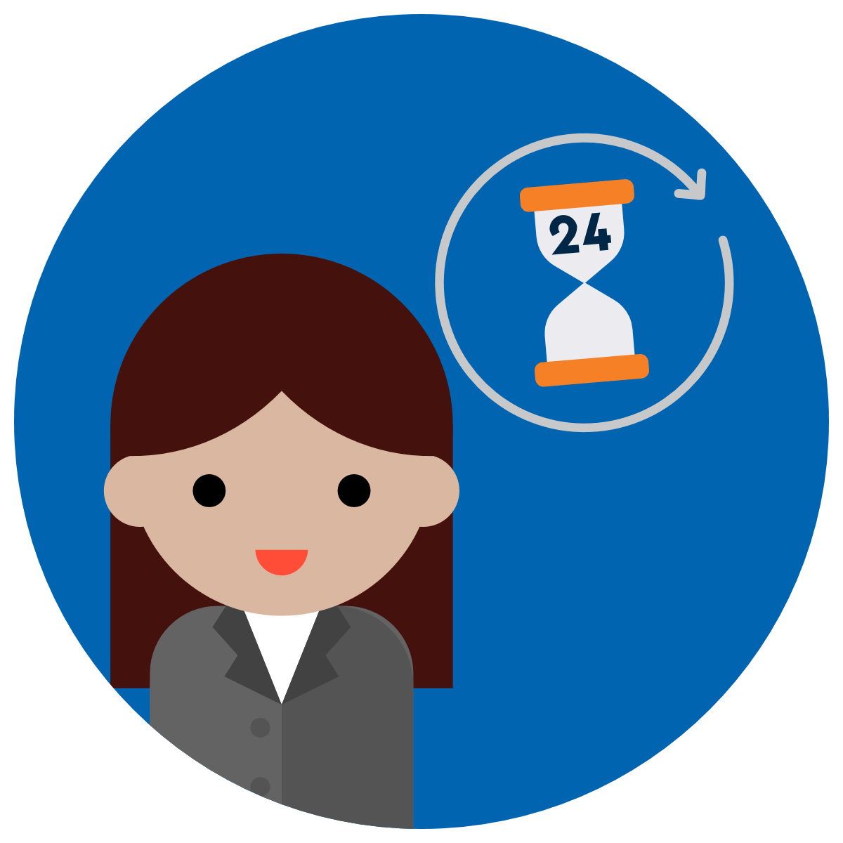
Plan for an Effect on Daily Work Activities
Time
Coordinate your appointment with your department to ensure coverage for critical business activities.
Reschedule appointments and clear your calendar to allow time for the update.
Set time on your calendar to prepare your device for the update.
See the previous slides for time estimates on each phase.
Device Access
You may be without a computer for up to 24 hours while your device is updated.
It may also take up to 24 hours to set up the device after picking it up.
Contact the Help Desk if you have concerns that may hinder your ability to complete these steps.
Understand the actions required and the extent of the update by reviewing the project website.

Slide 11



Drop Off Your Device (~15 to 30 minutes)
Drop Off
Your Device
Receive a
Notification
Sign in to
Your Email
Wait for OIT
to Contact You
Drop off your device and power cord at Wetsel Service Center (WET)
Room 106.
You will receive an email notification
to verify that you
have dropped off
your device and power cord.
Before leaving, you will log into your email and verify the information on the notification.
It may take up to 24 hours to reimage each device after drop off.

Slide 12
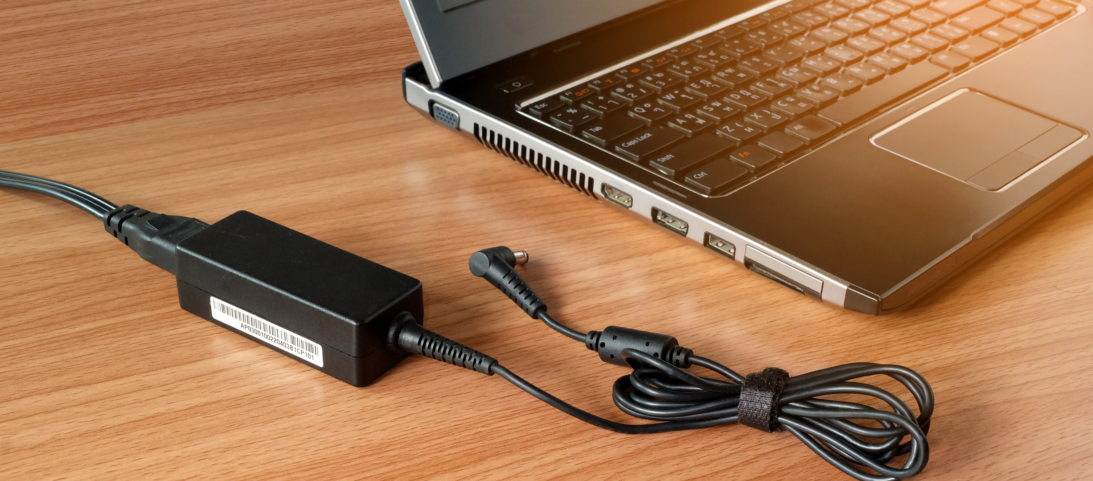
Remember to Bring Your Power Cord!

Slide 13




Pick Up Your Device (~15 to 30 minutes)
Receive a
Notification
Schedule an
Appointment
Pick Up
Your Device
Log In to
Your Device
You will receive an email notification when your device is ready for pick up.
Schedule an appointment to pick up your device.
Pick up your
device and power cord at Wetsel Service Center
(WET) Room 106.
You will log into your device before leaving.
You will be asked to confirm device pickup.

Slide 14




Use and Set Up Your Device (~up to 24 hours)
Use MyApps During Reload
Use Outlook
Web App
Finish Device
Set Up
Reinstall
Software
It may take 1-3 hours to install University-owned applications. Use MyApps to access web versions of 365 applications
during reload.
Wait for all 365 applications to finish installing before using the Outlook desktop application. Use the Outlook web app in the interim.
See if you need to reinstall software by comparing the Software Tracking Form to the applications installed or installing on your device.
Reinstall software that was not automatically installed by OIT after the update (including purchased and free applications.)

Slide 15
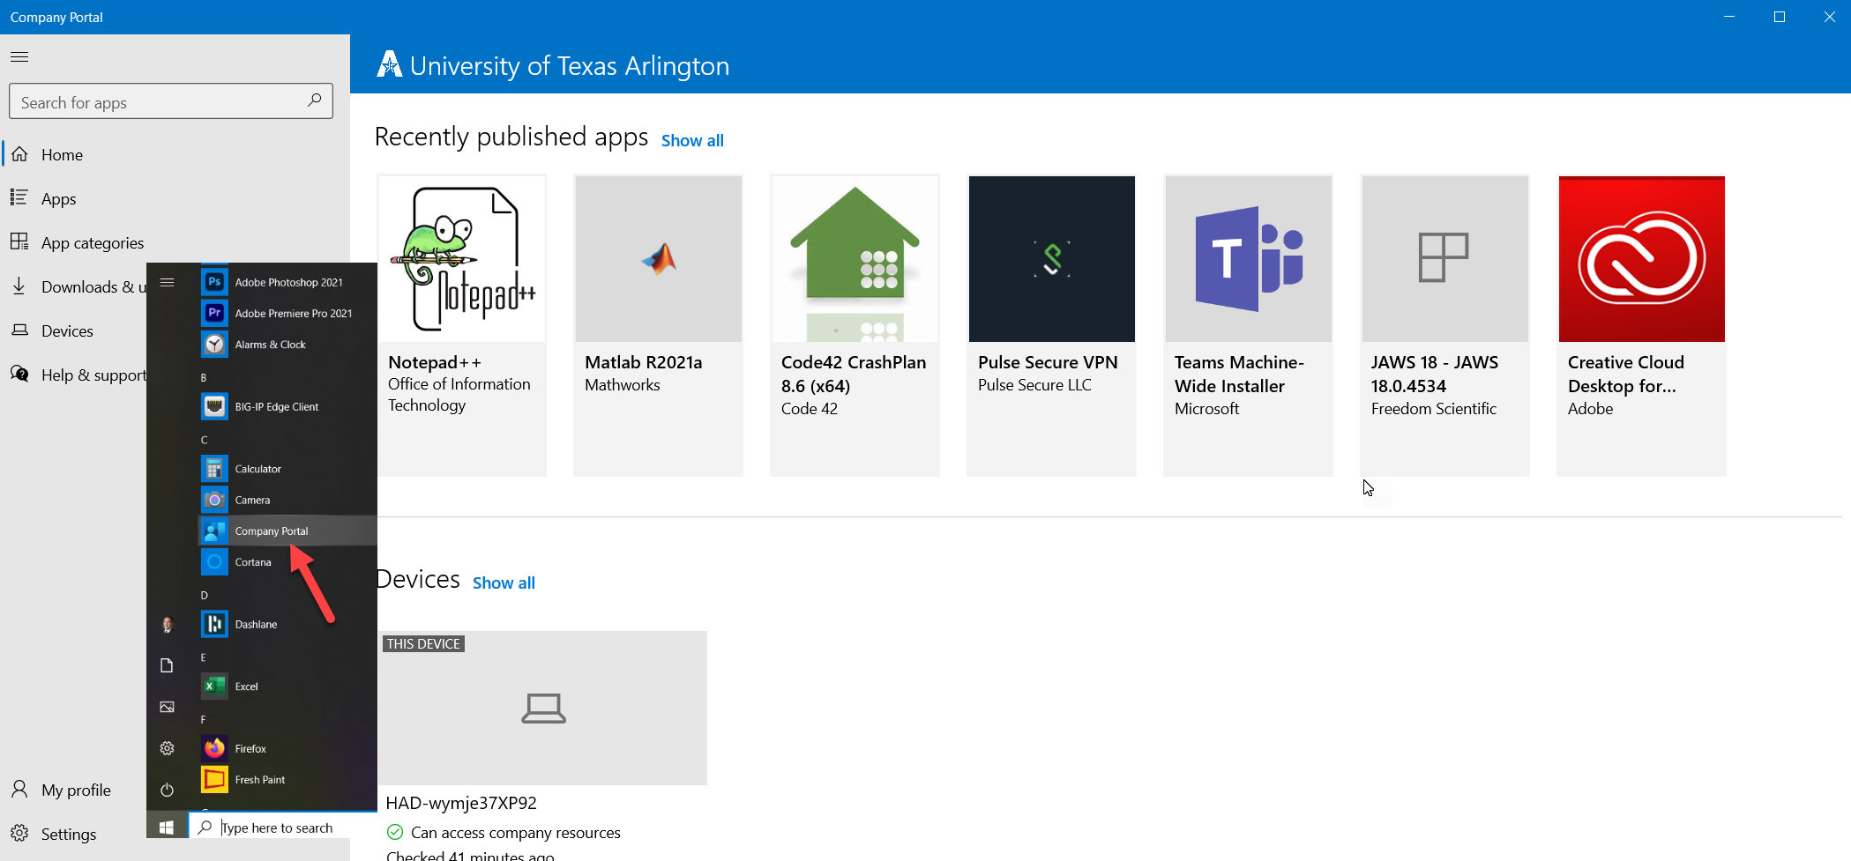
Use Company Portal App to Obtain Additional Software

Slide 16
Use Outlook Desktop for the First Time
What to Know About Using Outlook for the First Time on Desktop
The desktop Outlook 365 client must pull down all email and calendar information from the cloud
Emails will download first, and calendar data will come after
The calendar on the desktop will be empty until email downloads completely
Downloads can take up to 24 hours depending on bandwidth and content
The Outlook web client is fully available during this time for conducting business

Slide 17




Access More Information
Project
Website
Help
Page
Extended
FAQ
Help
Desk
Review the project website for more information.
Email the project team with questions.
Visit the project Help page for support.
See these tips for using and setting up your device.
See the extended frequently asked questions for details.
Contact the Help Desk at 817-272-2208, via chat or by submitting a self-service ticket.

Slide 18
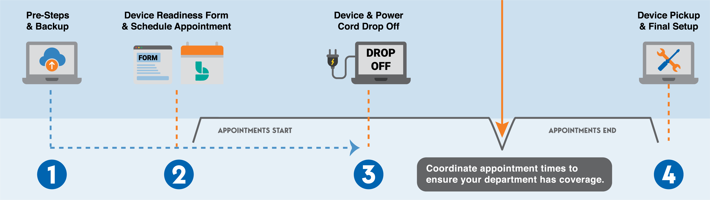
Review the Process Timeline

Slide 19

About Exception Requests
About Exception Requests

Slide 20
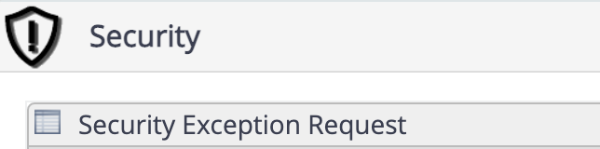
Exception Requests
Exceptions may be permitted
per IT-PO-03:
"Exception to an otherwise required security control may be granted by the Information Security Office (ISO) to address specific circumstances or business needs relating to an individual program or department, only as authorized by application law, System and University Policy."
"All granted exceptions are subject to review and revocation at any time by the ISO as required to maintain, adapt to, or otherwise support the University’s security posture."
"Exception requests not approved by the ISO may be appealed to the President or designee."
How to Request an Exception
Request an exception using the Security Exception Request form in ServiceNow.
Access the form by clicking the link above, or by choosing "Request Something" on the main page in ServiceNow. Scroll down to the "Security" tile.

Slide 21


Frequently Asked Questions About Exceptions
How do I know if I have a valid exception on file?
What if I have an exception already filed with ISO?
How do I file an exception for my device(s)?
If you have or believe you might have an exception on file, email security@uta.edu to confirm.
ISO provides exceptions and can report the status to you.
Devices with previous exceptions must be renewed annually with ISO.
Email security@uta.edu
to renew an exception.
Exceptions can be filed electronically using the Security Exception Request form in ServiceNow.

Slide 22

Q&A
Q & A

